Slide 1
The Equations of Motion with Polar Coordinates
Dr. Jacob Moore
Associate Professor of Engineering
Penn State Mont Alto

Slide 2
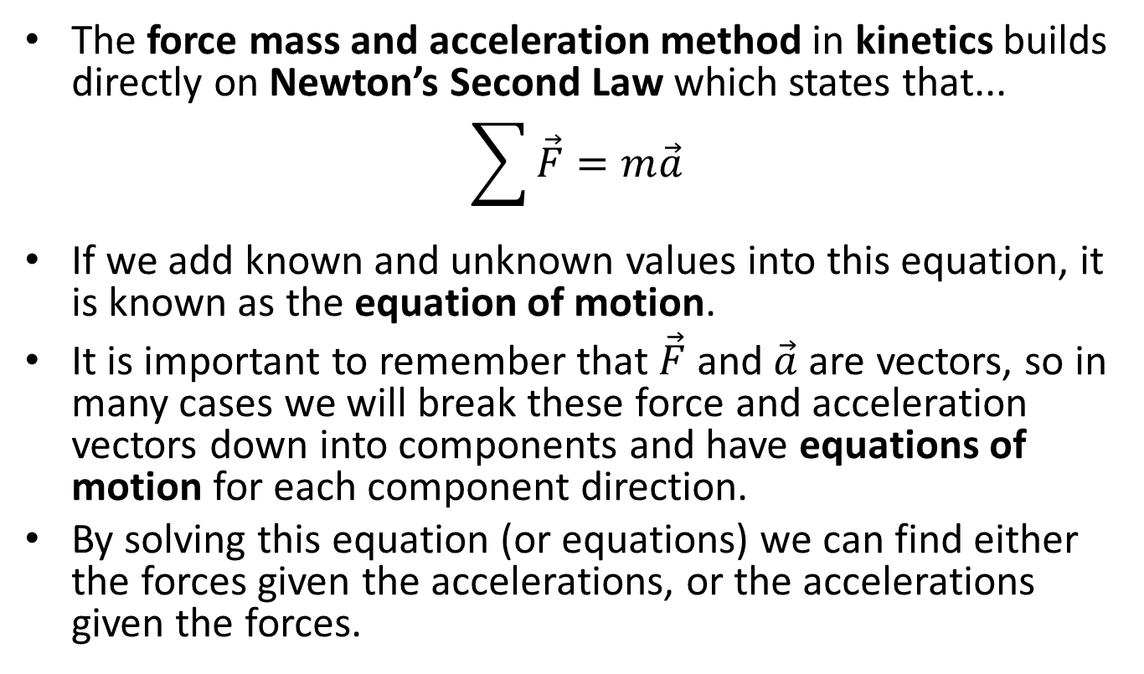
Newton’s Second Law and the Force Mass and Acceleration Method
The force mass and acceleration method in kinetics builds directly on Newton’s Second Law which states that...
$$\sum{\vec{F}}=m\vec{a}$$
If we add known and unknown values into this equation, it is known as the equation of motion.
It is important to remember that $\vec{F}$ and $\vec{a}$ are vectors, so in many cases we will break these force and acceleration vectors down into components and have equations of motion for each component direction.
By solving this equation (or equations) we can find either the forces given the accelerations, or the accelerations given the forces.

Slide 3
Force Method in Two Dimensions
Now we will have two equations of motion for polar coordinates.
$$\sum{F_{r}=ma_{r}}$$
$$\sum{F_{θ}=ma_{θ}}$$
The polar coordinate system is employed in instances where we are tracking an object from a ground point or instances of rotational motion.

Slide 4


Forces in Polar Directions
We will fill in details on the forces in each direction using a free body diagram.
It’s important break any known of unknown forces down into r and theta components.
$$θ$$
$$F$$
$$φ$$
$$r$$
y
$$F_{θ }=F sin⁡(φ)$$
$$F_{r}=F\cos{(φ)}$$
$$r$$
$$θ$$
x

Slide 5
Acceleration in Polar Coordinates
We will fill in details on the accelerations by looking back at the kinematics
When examining the kinematics of polar coordinates, we found the acceleration in r and theta directions to be...
$$a_{r}=\ddot{r}−{r\dot{θ}}^{2}$$
$$a_{θ}=r\ddot{θ}+2\dot{r}\dot{θ}$$

Slide 6
Solving a Kinetics Problem (The Process)
The process used in solving a kinetics problem is similar to solving a problem in statics and consists of three steps.
Set up a free body diagram.
Draw the body separated from it’s surroundings
Draw in all the known and unknown forces (I use red for forces) as well as key dimensions and angles (I use blue for dimensions and angles)
Draw in the acceleration vector (I use a blue dashed vector for this)
Use the free body diagram to write out your equations of motion, breaking all forces and accelerations down into r and theta components
These may be supplemented with kinematics equations.
Solve the equations for any unknowns.

Slide 7
Thanks for Watching
See other engineering mechanics videos and access the full tool at…

Slide 8


Kinetics with Polar Coordinates Worked Example
A device consists of two ½ kg masses tethered to a central shaft. The tethers are each .75 meters long and each tether currently makes 25-degree angle with the central shaft. Assume the central shaft is spinning at a constant rate.
What is the rate at which the shaft is spinning?
If we want it to spin at exactly 100 rpm, what should the angle of the tethers be?
$${25}^{o}$$
$$\dot{θ}=?$$

Slide 9

Kinetics with Polar Coordinates Practice Problem
A catapult design consists of a steel weight on a frictionless rod. The rod spins at a constant rate of 4 radians per second and when theta is 45 degrees from horizontal, the 30 lb weight is released from its position 2 ft from the center of rotation of the shaft.
What is the force the shaft exerts on the weight at the instant before and the instant after it is released?
What is the acceleration of the weight along the shaft the instant after it is released?
4 rad/s
2 ft
$$θ$$

